Slide 1

Auditing Your SQL Server For Security, PCI, SOX and Data Access
Eric Peterson
Data Architect
Ingo Money

Slide 2
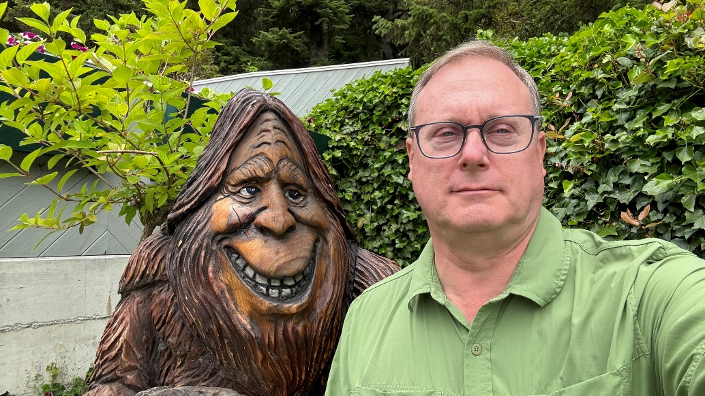



Background
Over 40 years of Database experience
DB2, Sybase, MS SQL Server, Oracle
Over 30 years of SQL Server experience
SQL Server 4.2, 1993 with Sybase
Former Sybase Lead Architect
sp_who2
Coleader Atlanta MDF SQL Data User Group
Avid Hiker & National Park Junkie
Beer Aficionado

Slide 3



Agenda
What and how to audit SQL Server for:
Compliance: PCI, SOX, Client/Customer/Consumer
SQL Server Access
Security data issues
Data Usage
What it is not:
Not a definitive guide for the full PCI/SOX audit
All Scripts are located in GITHUB
https://github.com/SQLeap61/PASSAuditingPresentation
Don’t hesitate to ask questions

Slide 4
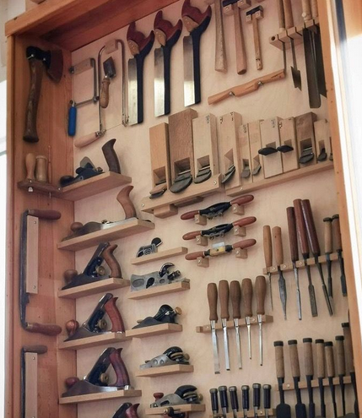
The standard Audit Myth
PCI: Payment Card Industry
PCI DSS: Payment Card Industry Data Security Standards
Certifications Available (mandatory)
SOX: Sarbanes-Oxley
Classes Available, No Certification
Cyber Liability Insurance
Consumer Privacy ( CCPA, GDPR, HIPPA )
Law Enforcement

Slide 5
PCI DSS: Six principles
Build and maintain a secure network and systems
Protect cardholder data
Maintain a vulnerability management program
Implement strong access control measures
Regularly monitor and test
Maintain an information security policy

Slide 6
the 12 Requirements of PCI DSS
Install and maintain a firewall to protect cardholder data environments.
Don't use vendor-supplied default passwords and other security parameters.
Protect stored cardholder data.
Encrypt payment card data transmitted across open, public networks.
Use and regularly update antivirus software.
Develop and maintain secure systems and applications.
Restrict access to cardholder data to employees with a business need.
Assign a unique ID to each person with data or computer access.
Restrict who has physical access to cardholder data.
Track and monitor all access to network resources and cardholder data.
Regularly test security systems and processes. <<< Security Review Auditing
Maintain an information security policy.

Slide 7
Sarbanes-Oxley Act of 2002
Organizations must audit their financial statements on a yearly basis.
The main objective is accuracy of a company's financial statements
Proof of all SOX internal controls for data security and accurate financial reporting must be provided for the SOX audit.
Section 302: Corporate Responsibility for Financial Reports
Section 404: Management Assessment of Internal Controls
Section 409: Real-Time Issuer Disclosures
Section 802: Criminal Penalties for Altering Data\Documents
Section 906: Corporate Responsibility for Financial Reports

Slide 8
Cyber Liability Insurance
Insurance for cyberattacks and data breaches ransomware attacks, data recovery, and legal fees.
It helps cover costs related to incidents
You will need to provide Infrastructure specific documentation

Slide 9
PCI vs PII
PCI
Credit Card/ Account Information
Encrypt
Never Store the Security Code
PII – Personally Identifiable Information
Name, Address, Phone, ETC
Encrypt SSN, Passport, Drivers License
Mask Fields According to Company Policies

Slide 10
Technique vs Audit Procedures
Technique
Techniques to quickly get the information
Differentiate between On Prem and Azure
How to Document
Info Stored Procedures
Deployed to each of your SQL Servers
Modify to work across multiple versions of SQL Server
Translates Raw Data into Readable Format
IE: Reports That the Auditors Can Use

Slide 11
Tecnique: Multiple Server Queries
This works best when run against all servers at once
Will only sort within each server.
Final result set is by server
See the demo

Slide 12
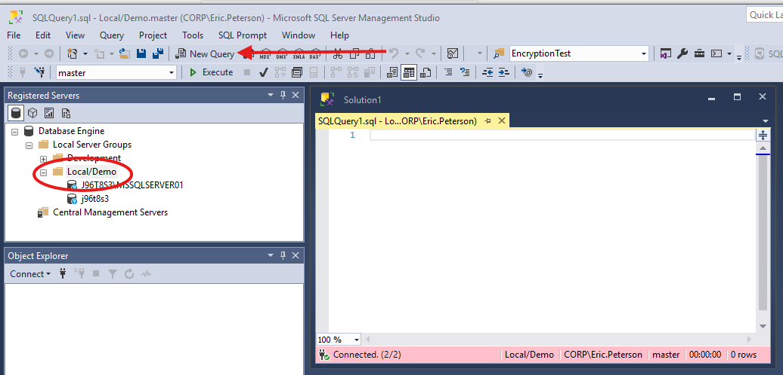
Multiple Server Demo

Slide 13
Audit Requirement: Document all SQL ServerS
Sp_Serverinfo
Quick snapshot of
SQL Server Name, host computer, ip address, port, CPU/Memory
PCI/SOX
Version, Build Number, Patch level, OS Release
DR information including (HADR – Always available) & Clustering

Slide 14
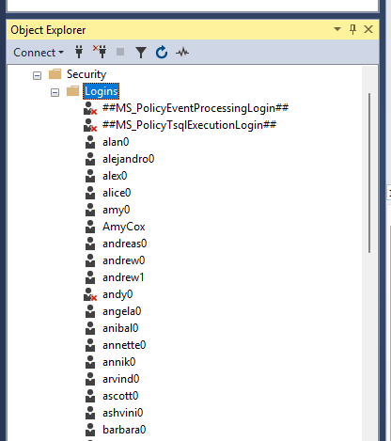
Audit Requirement: Document access Controls
sp_auditinfo
List of Every login
Last access, modify date
Active/Disabled
Server Roles
User mapping to each database
Read/Write/Update/Schema change/DBO
Audit
PCI/SOX
CyberSecirity
Document process – Print Email Requests

Slide 15
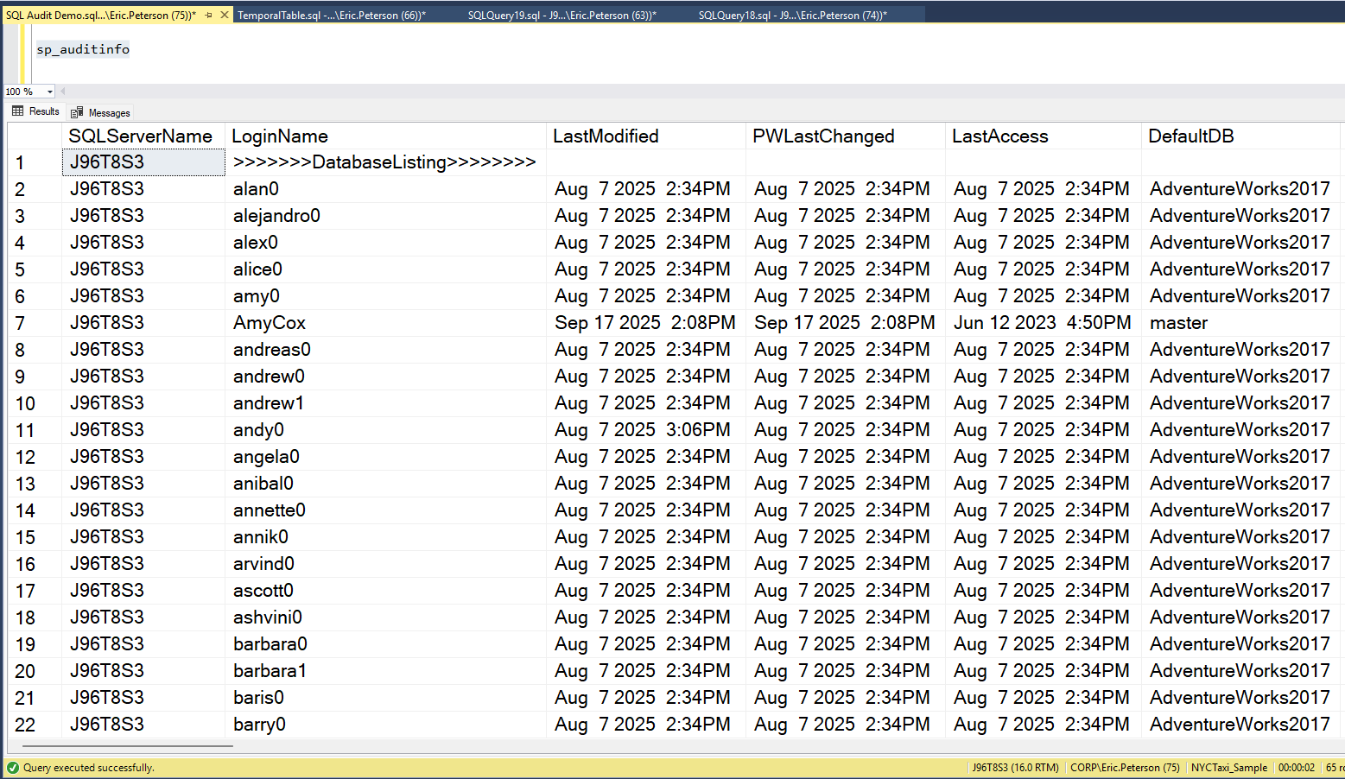
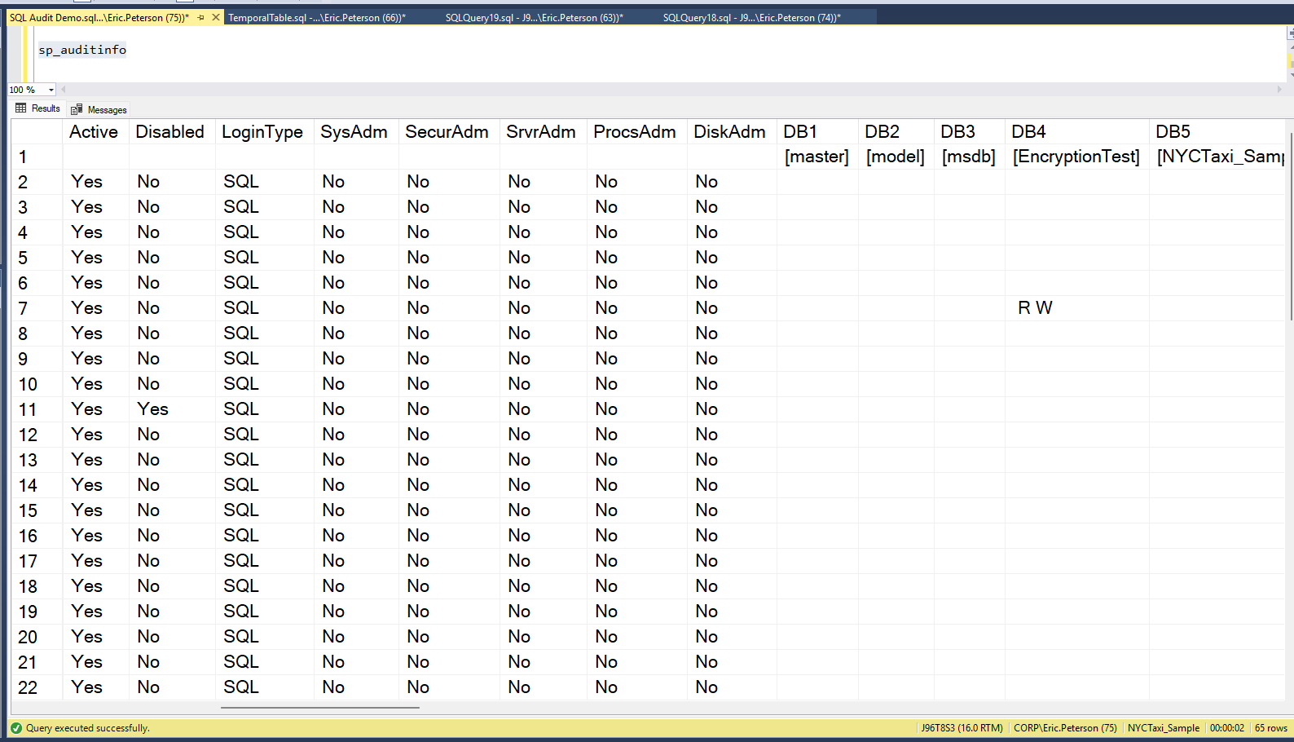
Sp_AuditInfo

Slide 16
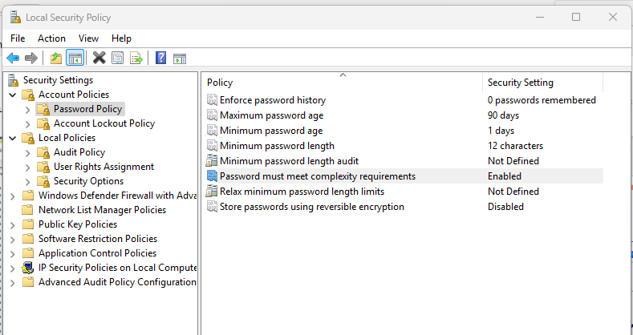
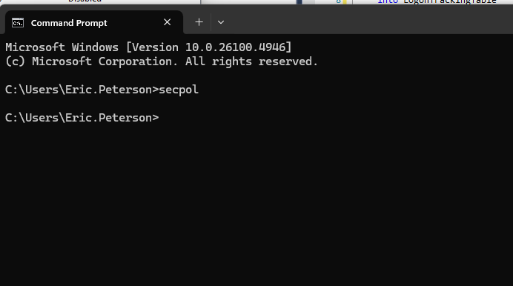
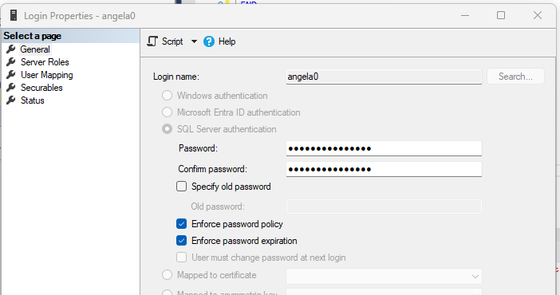
Audit Password rotation
PCI DSS 4.0
12-character minimum must with
mix of uppercase, lowercase letters, numbers, and special characters
ChangeFrequency – Every 90 days

Slide 17
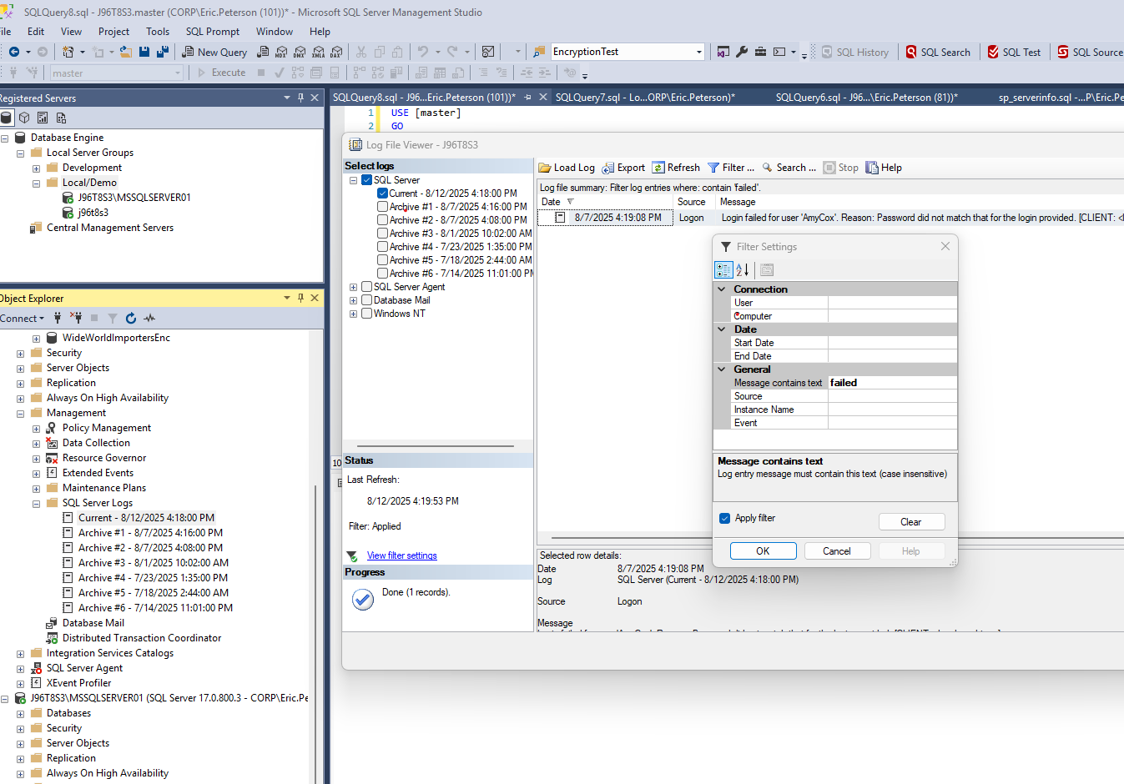
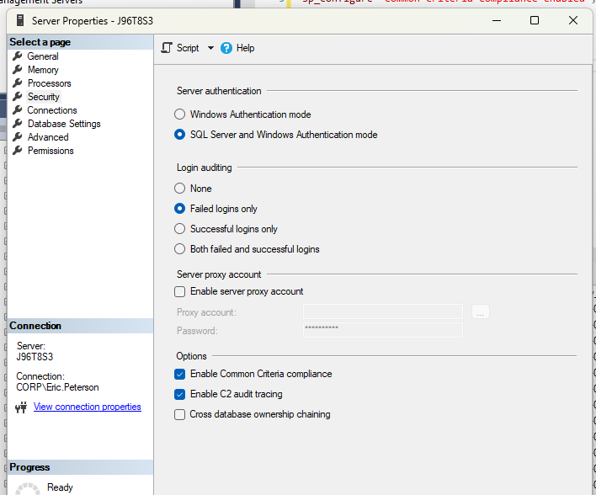
Audit Requirement: Monitoring access
EXEC xp_ReadErrorLog 0, 1, N'login failed'
Sp_ErrorMessageInfo
Upon login Failure you will be emailed the following:
On J96T8S3, 1 failed Login(s) were detected within the past 5 minutes. The last message = Login failed for user 'AmyCox'. Reason: Password did not match that for the login provided. [CLIENT: <local machine>]
Schedule into SQL Agent Job
Run every 5 minutes

Slide 18
Audit requirement: Track all access
CREATE OR ALTER TRIGGER LogonTrigger
ON ALL SERVER
FOR LOGON
AS
BEGIN
Insert Original_Login(), getdate(), clientHost
into LogonTrackingTable
END

Slide 19
Audit: Backup & Recovery
Document Backups
Backup Encryption
Immutable Storage
Cloud
AWS
Azure
Managed Instances
Disaster Recovery Plan

Slide 20
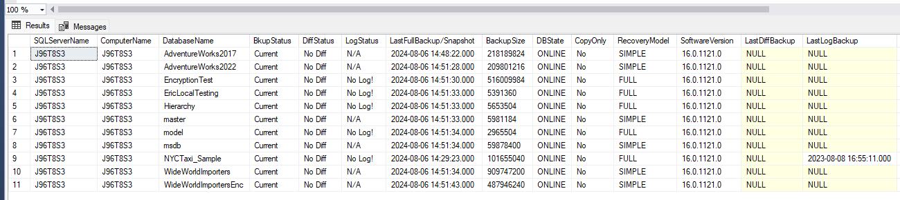
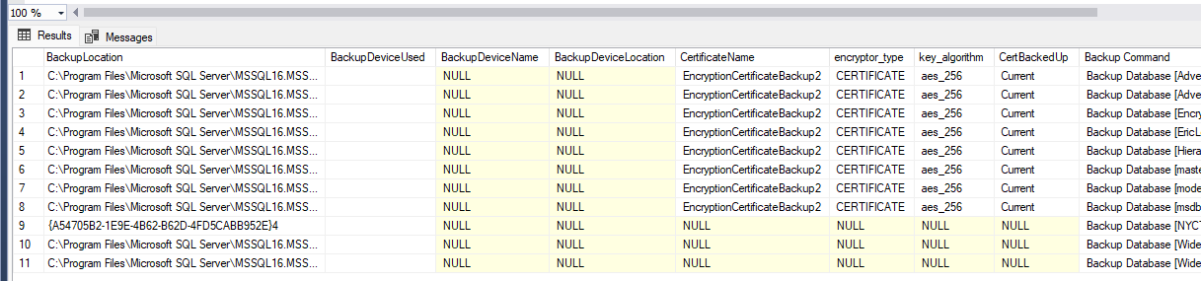
Document w/SP_Backupinfo

Slide 21
Encryption at rest
Proof of encryption at rest
A tool like bitlocker will not protect your system from a simple copy
TDE vs Encrypted backups

Slide 22
Full Database Encryption
TDE – Transparent Data Encryption
Backups will be encrypted if the DB already is…
CREATE DATABASE ENCRYPTION KEY
WITH ALGORITHM = AES_256
ENCRYPTION BY SERVER CERTIFICATE MyServerCert;
ALTER DATABASE AdventureWorks2022
SET ENCRYPTION ON;

Slide 23
Encryption & Certificate Info
Query for which databases are encrypted
SELECT sd.name,
sd.is_encrypted
FROM sys.databases sd
LEFT OUTER JOIN sys.dm_database_encryption_keys dd
ON sd.database_id = dd.database_id;
sp_CertificateInfo

Slide 24


Encrypted Backups Architecture
Setup Master Key
Installed on all Production SQL Servers
Setup Certificate
Installed on all SQL Servers
and backed up
Backup Certificate with a PASSWORD
Backup Databases with Encryption
Restore is automatic w/certificate

Slide 25

How Encrypted Backups Work – Create Master Key
SQL Server
IF NOT EXISTS (SELECT * FROM sys.symmetric_keys WHERE symmetric_key_id = 101)
BEGIN
PRINT 'Creating Database Master Key'
CREATE MASTER KEY
ENCRYPTION BY PASSWORD = 'T0t0, I Dont Th!nk WE @re in Kansas anymore!';
END
ELSE
PRINT 'Master Key Already Exists'
Database 1
Database 2

Slide 26

How Encrypted Backups Work - Create A Certificate
SQL Server 1
CREATE CERTIFICATE EncryptionCertificateBackup2
WITH SUBJECT = 'SQL Server Backup Encryption Certificate',
EXPIRY_DATE = '20311114’;
CREATE CERTIFICATE EncryptionCertificateBackup1
ENCRYPTION BY PASSWORD = 'A R@nd0m1y G3nerated Pa$$w0rd’
WITH SUBJECT = 'SQL Server Backup Encryption Certificate',
EXPIRY_DATE = '20311114';
Database 1
Encryption
Certificate
System1
Database 2
If you supply a Password, you have to supply the PW when taking your backup.
Expiry Date: you will need a new certificate after this date. Note: It will still work for restores

Slide 27


How Encrypted Backups Work - Backup Certificate
SQL Server 1
Directory or S3 Bucket
Database 1
BACKUP CERTIFICATE EncryptionCertificateBackup2
TO FILE = 'c:\storedcerts\EncCertBackup1.BAK’
WITH PRIVATE KEY
( FILE = ' 'c:\storedcerts\ EncCertBackup1.PKK' ,
ENCRYPTION BY PASSWORD
= '>Save This P@$$word in y0ur Password VaulT’ );
GO
Database 2

Slide 28



How Encrypted Backups Work – Backup Database
SQL Server 1
Encrypted Backup Database 1
Encrypted Backup Database 2
Database 1
Backup Database [Database1]
to disk = 'C:\Backups\Database1-20240114105500.BAK'
with compression ,
ENCRYPTION
(ALGORITHM = aes_256,
SERVER CERTIFICATE =
EncryptionCertificateBackup2)
If using Ola Hallengren’s scripts
@Encrypt = 'Y' ,
@EncryptionAlgorithm = 'AES_256' ,
@ServerCertificate = EncryptionCertificateBackup2',
Database 2

Slide 29

How Encrypted Backups Work - Restore Databases
SQL Server 1
Encrypted Database 1 Backup
Encrypted Database 2 Backup
Database 1
Restore Database [Database1]
From disk = 'c:\Backups\Database1-2023-01-09_105500.BAK’
WITH RECOVERY
Database 2
Because the certificate exists, the restore works!
If you have a Passworded certificate, you have to supply the PW when restoring.

Slide 30

How Encrypted Backups Work – New SQL Server
$#1T
Happens
SQL Server 1
Encrypted Database 1 Backup
Encrypted Database 2 Backup
Database 1
Database 2

Slide 31
How Encrypted Backups Work - Rebuild SQL Server
SQL Server 2
Encrypted Database 1 Backup
Encrypted Database 2 Backup

Slide 32
How Encrypted Backups Work - Restore Database?
SQL Server 2
Encrypted Database 1 Backup
Cannot Restore an Encrypted Backup
Encrypted Database 2 Backup

Slide 33

How Encrypted Backups Work - Recreate Master Key
SQL Server 2
Encrypted Database 1 Backup
Encrypted Database 2 Backup
CREATE MASTER KEY
ENCRYPTION BY PASSWORD
= 'T0t0, I Dont Th!nk WE @re in Kansas anymore!';

Slide 34
How Encrypted Backups Work - Restore Certificate
SQL Server 2
Encrypted Database 1 Backup
Encrypted Database 2 Backup
CREATE CERTIFICATE EncryptionCertificateSystem1
FROM FILE = 'c:\storedcerts\System1EncCert.bak’
WITH PRIVATE KEY ( FILE = 'c:\storedcerts\System1EncCert.PKK’
DECRYPTION BY PASSWORD
= '>SaveD P@$$word y0ur Password VaulT';

Slide 35
How Encrypted Backups Work - Restore Databases
SQL Server 2
Encrypted Database 1 Backup
Encrypted Database 2 Backup
Database 1
Restore Database [Database1]
From disk = 'c:\Backups\Database1-2023-01-09_105500.BAK’
WITH RECOVERY
Database 2

Slide 36

How Encrypted Backups Work
SQL Server 2
Encrypted Database 1 Backup
Encrypted Database 2 Backup
Database 1
Back in Business
Database 2

Slide 37
Immutable Storage for Backups
Write once, modify never
Helps against encrypted ransomware attacks
AWS S3
“S3 Object Lock” to prevent objects from being deleted or overwritten
Need to have S3 Versioning enabled
Azure Blob Storage
Create an immutability policy

Slide 38
Audit: Disaster Recover Plan
Document
Estimated Time of Recovery
Local VS Cloud
Multi Cloud

Slide 39
Auditing Data changes
Data that you need to keep forever
Date sensitive
What happened at a specific time
Use a Ledger Database
Use a Temporal Table

Slide 40
Ledger Database
Protect data from any anyone
Preserves Historical data
Transparent without data changes
Create database LedgerDemo
with ledger = on;

Slide 41
Find Ledger and View
SELECT
ts.[name] + '.' + t.[name] AS [ledger_table_name]
, hs.[name] + '.' + h.[name] AS [history_table_name]
, vs.[name] + '.' + v.[name] AS [ledger_view_name]
FROM sys.tables AS t
JOIN sys.tables AS h ON (h.[object_id] = t.[history_table_id])
JOIN sys.views v ON (v.[object_id] = t.[ledger_view_id])
JOIN sys.schemas ts ON (ts.[schema_id] = t.[schema_id])
JOIN sys.schemas hs ON (hs.[schema_id] = h.[schema_id])
JOIN sys.schemas vs ON (vs.[schema_id] = v.[schema_id])
WHERE t.[name] = 'Hotel';

Slide 42
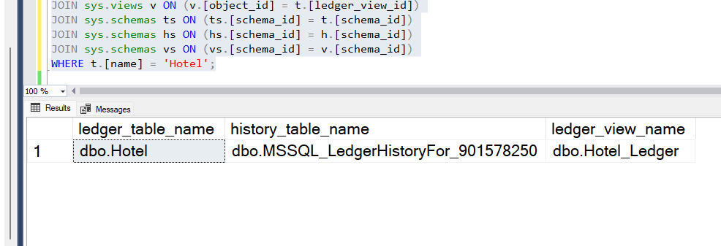
Table and View Results

Slide 43
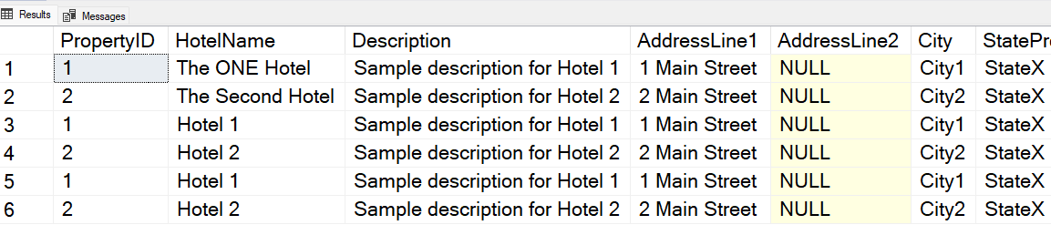
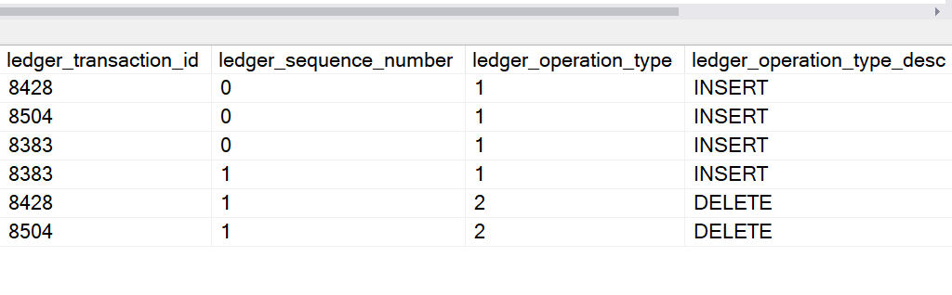
What is Ledger Tracked
A complete record of before and after
NEW

Slide 44

Temporal Tables
AKA: System-versioned table.
Every version of every row
Insert, update, delete
Begin and end time for each row
Stores data in a mirrored historical table
Must be in the same database
1C
2A
3B
1A
1B
3A

Slide 45
How Temporal Tables work
Automatic Mirrored historical table
Must have primary key W/ two datetime2 columns
Shows period of validity for each record
Insert
End time set to 9999-12-31, nothing in history
Update
A new record is added to History for each update
Delete
Delete from primary, final record added to history
NOTE: You cannot edit a historical table

Slide 46
Temporal Setup
--*************************** Table has have a primary key *************************
ALTER TABLE Hotel
ADD CONSTRAINT PK_Hotel_PropertyId PRIMARY KEY CLUSTERED (PropertyId);
GO
--********** Table has to have a Period columns: SysStartTime, SysEndTime **********
ALTER TABLE dbo.hotel
ADD SysStartTime DATETIME2 GENERATED ALWAYS AS ROW START ---- HIDDEN
CONSTRAINT DF_Hotel_SysStartTime DEFAULT SYSUTCDATETIME(),
SysEndTime DATETIME2 GENERATED ALWAYS AS ROW END
CONSTRAINT DF_Hotel_SysEndTime
DEFAULT CONVERT (DATETIME2, '9999-12-31 23:59:59.9999999'),
PERIOD FOR SYSTEM_TIME (SysStartTime, SysEndTime);
GO

Slide 47
Temporal Table Setup
ALTER TABLE Hotel
SET (SYSTEM_VERSIONING = ON (HISTORY_TABLE = History.Hotel));
GO

Slide 48
SQL for History Querying
Old School – Query both tables
Select * from Hotel WHERE Id = 129
union all
Select * from History.Hotel WHERE Id = 129
order by SysEndTime desc
Temporal extensions
Select * from Hotel WHERE Id = 129
AS OF
From
Between
Contained In

Slide 49
Temporal SQL Extensions
AS OF <date_time>
SysStartTime <= AND SysEndTime >
Returns a single row for point of time.
Result can be in base or history table
SELECT *
FROM hotel --< Notice goes against the base hotel table
FOR SYSTEM_TIME AS OF ‘2025-07-13 19:12:11.830' --< Current record
WHERE PropertyId = 129

Slide 50
Temporal SQL Extensions
From and Between
Returns multiple rows for range of time.
Almost identical, between matches upper and lower bounds
Scans both base and history table
SELECT *
FROM Hotel
FOR SYSTEM_TIME From ‘2025-06-26 16:43:37.5884050’
to ‘2025-06-26 17:03:11.830'
WHERE PropertyId = 1

Slide 51
Temporal SQL Extensions
Contained in
Returns multiple rows for range of time.
Records that were opened and closed within the time period specified.
Scans only history table
SELECT *
FROM Hotel
FOR SYSTEM_TIME
CONTAINED IN ('2015-06-26 16:43:37.5884050', '2015-06-26 17:03:11.830' )
WHERE PropertyId = 129

Slide 52
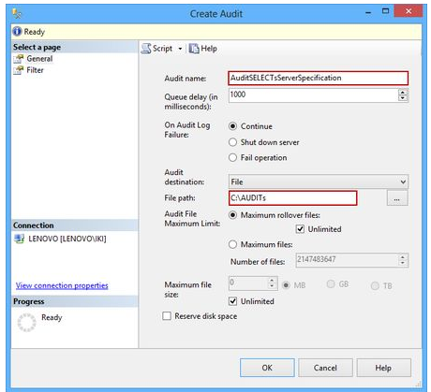
Auditing SQL Statements
Track all Statements for
Expand the Security folder
Select New Audit and set the Audit name
Set File

Slide 53
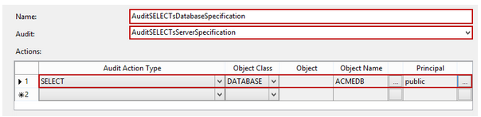
Audit Setup for Database
Expand the database you want to audit in Object Explorer
Expand the Security folder
Right-click the Database Audit Specification folder and select New Database Audit Specification
Name the Audit Specification
Principal: Public = Everyone

Slide 54
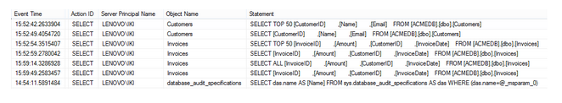
Auditing the Audit
Right click the AuditSELECTsServerSpecification audit and select the View Audit Logs option from the context menu to launch the audit log viewer dialog
The dialog will show the information about the SELECT statements issued on the particular database

Slide 55
Selecting against the Audit
SELECT
event_time ,
session_server_principal_name AS UserName ,
server_instance_name ,
database_name ,
object_name ,
statement
FROM sys.fn_get_audit_file('C:\AUDITs\*.sqlaudit', DEFAULT, DEFAULT)
WHERE
action_id = 'SL'
AND
database_name = ‘YourDB'

Slide 56
Auditing for Data Compliance
California: CCPA / EU: GDPR
Legal Requests
Tends to be your PII Information
Name, address, ETC.
SSN, passport number, drivers license number

Slide 57
Define your Customer
What fields make up a Customer/Client/User
What information you are tracking
Can the information be removed?
Masking PII data for users helps
for existing reports
Select queries

Slide 58
Encryption of Data
Appliance or Software
External to SQL Server
Certificate Encryption
Uses an internal certificate, password
Always Encrypted
Application Centric Encryption
123-45-6789
XXX-XXX-XXX
123-45-6789
XXX-XXX-XXX
123-45-6789
XXX-XXX-XXX

Slide 59

Dynamic Data masking
Defaults
Numeric: 000000
Datetime: 2000-01-01 00:00:00.000
String: XXXXXX
Email
Predefined Format: RXXX@XXXX.com
Partial
User Defined: XXX-XX-1234

Slide 60
Adding a Mask to a Table
ALTER TABLE MyCustomers
ALTER COLUMN [PurchaseTotAmt]
ADD MASKED --< the magic
WITH (FUNCTION = 'default()’)--< default on int
GRANT UNMASK TO TestUser;

Slide 61
Auditing your Encryption
Auditors just need to see your Account table
And the account information encrypted or masked

Slide 62
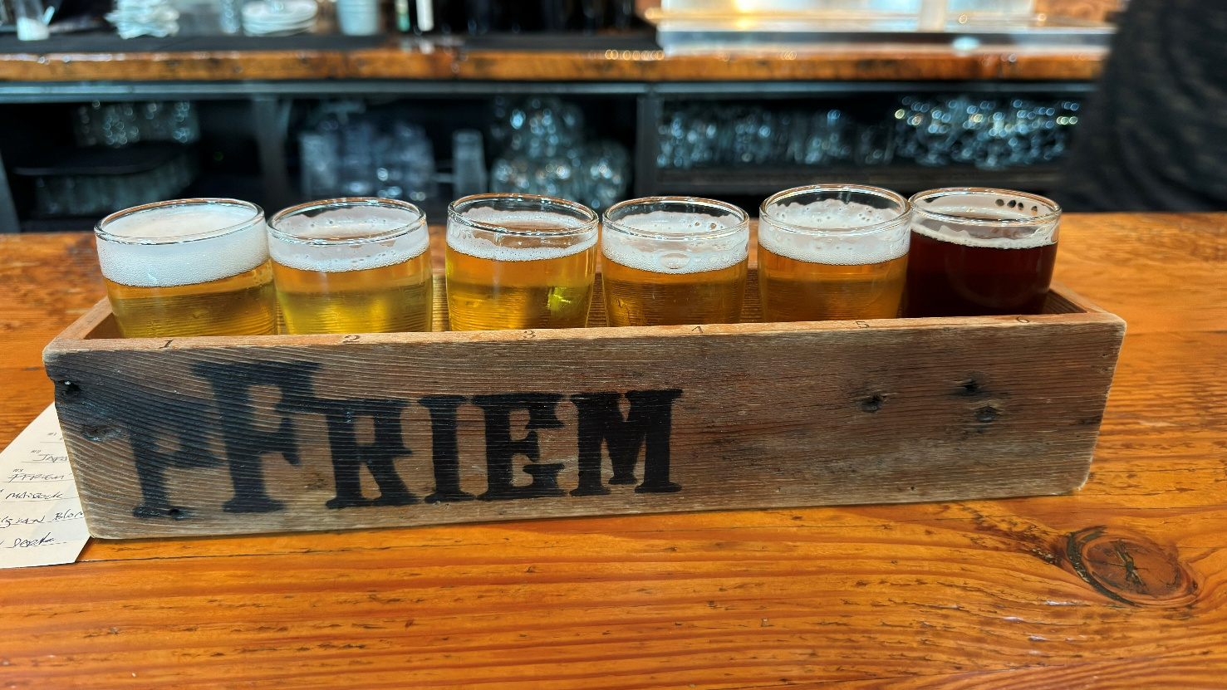
Eric Peterson
All Scripts are located in GITHUB
https://github.com/SQLeap61/PASSAuditingPresentation

Slide 63
Complicance What where and when

